Slide 1


Optic nerve sheat diameter and the diagnosis of increased intracranial pressure
Dr. Filippo Farina

Slide 2
Introduction
Elevated Intracranial Pressure (ICP) is a challenging and potentially fatal complication of various neurological disease.
ICP is determined by the volumes of brain, blood and cerebrospinal fluid within the skull.
An increase in volume of one of these components must be compensated for by a reduction in volume of one or both of the others.
If the compensation is insufficient, then ICP rises...

Slide 3
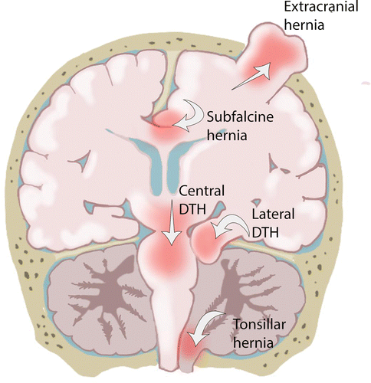
Introduction
Acute onset Intracranial Hypertension due to space occupying lesions (tumors, hemorrhagic or ischemic stroke, abscess, etc) can cause herniation of portions of brain with catastrophic consequences.

Slide 4
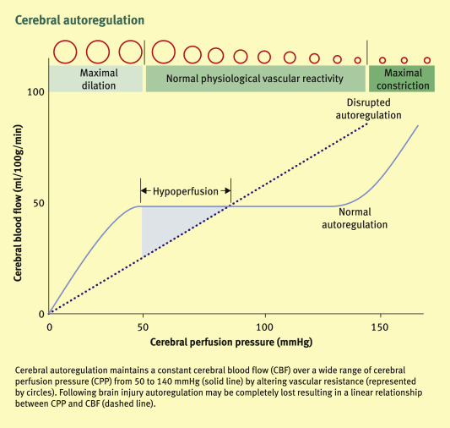
Introduction
As ICP rises, a vicious cycle of further brain swelling and secondary brain injury occurs. This can result in compromised brain circulation causing cerebral ischaemia.
Once the ICP equals the brain perfusion pressure, blood will be unable to enter the brain resulting in massive infarction.

Slide 5
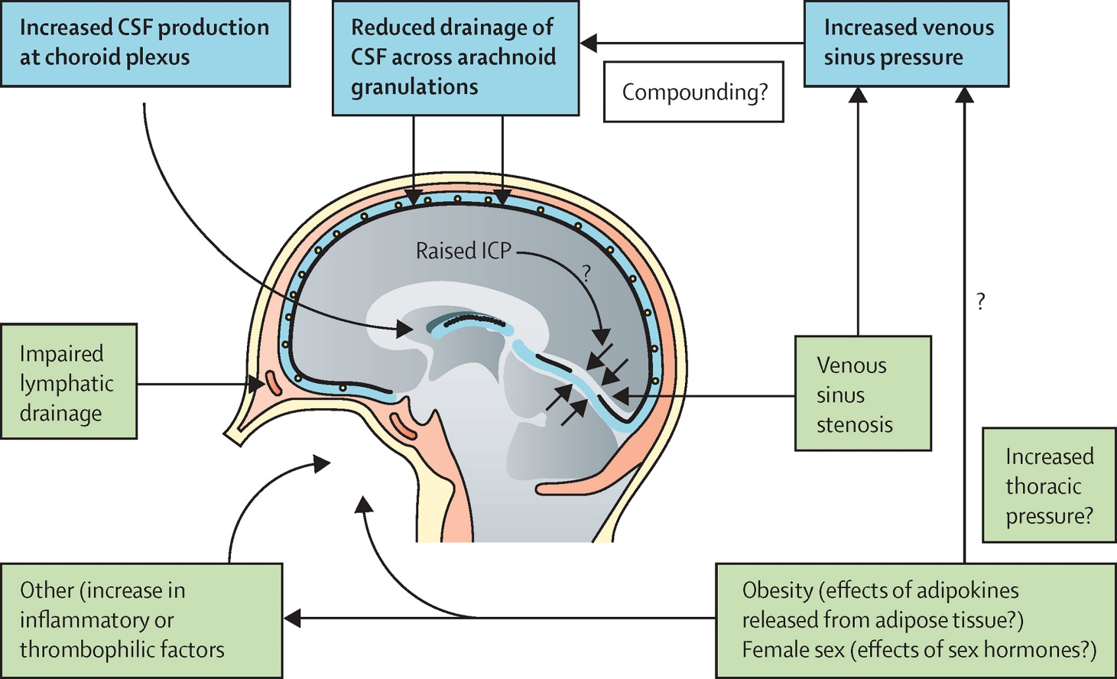
Introduction
In addition to acute causes of ICP rise, there are subtle clinical cases of idiopathic intracranial hypertension syndromes (IIHs) that can lead to irreversible neurological damage over time if not treated.

Slide 6
Introduction-how to measure ICP?
Invasive methods to monitor ICP include:
-intraventricular catheter,
-extraventricular drain,
-intraparenchymal probes,
-subarachnoid bolts.
Nowadays, the intraventricular monitoring of ICP is considered as gold standard for ICP measurement.
While invasive methods of ICP monitoring give the advantage of precise and accurate measurements, placement of intra ventricular drain is associated with numerous complications such as difficult placement, haemorrhage, infections, incorrect placement as well as those related to sudden decompression.

Slide 7
Introduction-how to measure ICP?
The non‑invasive methods of monitoring ICP include:
-ultrasound measurement of optic nerve sheath diameter (ONSD),
-MR measurement of ONSD,
-tympanic membrane displacement,
-quantitative pupillometry and opthalmodynamometry

Slide 8

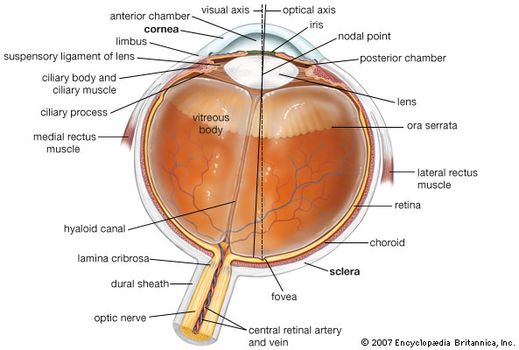
Anatomical Background

Slide 9
Anatomical Background
Optic nerve sheath is an extension of the dura mater enclosing the optic nerve up to the back of the eye

Slide 10
Anatomical Background
When ICP rises, cerebrospinal fluid (CSF) is pushed towards the tiny rim of subarachnoid space between the sheath and the nerve, causing an expansion of the dural covering.
These changes are more marked in the anterior part of the nerve sheath behind the globe.

Slide 11
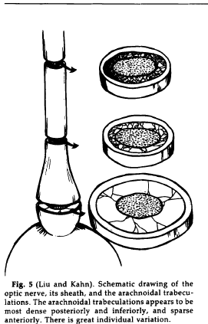
Anatomical Background
A correlation between the dilation of the ONS and intracranial pressure was observed in several experimental settings since 1975 .
…especially in the distal part of the nerve due to its anatomical features (less aracnoidal trabeculatures)
There is a linear correlation between ICP rise and dilation of ONS…

Slide 12
Anatomical Background
Some authors showed how the optic nerve sheath diameter (ONSD) could react “in vivo” after an experimental intrathecal infusion of fluid through a lumbal puncture. The ONSD could expand from the baseline ONSD about 1.8 mm (range 0.7-3.1 mm), corresponding to an ONSD variation of 45% (range 15-89%).

Slide 13
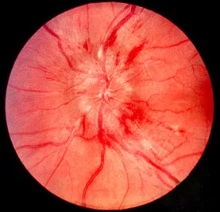
Anatomical Background
Papilledema refers to edema of the retinal disc, and it is considered as another landmark of elevated ICP. It was traditionally diagnosed with an ophthalmoscope.
While papilloedema may take time to develop, dilation of the
optic nerve sheath occurs near-instantaneous manifestation of raised intracranial pressure

Slide 14
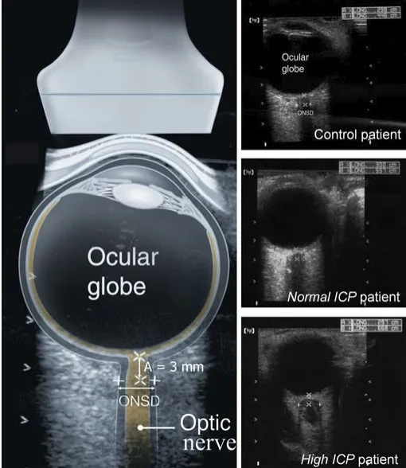
Ultrasound examination

Slide 15
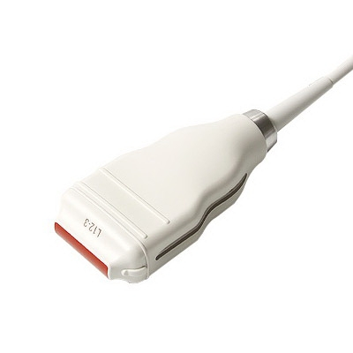
Technical Requirements
-The examination should be performed with linear probe (>7,5 mHz), with a lateral resolution of at least 0,4 mm
According to current recommendations on orbital insonation:
Mechanical index (MI) must be adjusted below 0.2
Thermal index (TI) must be below 1.0
the total insonation time must be kept as low as possible (ALARA principles)

Slide 16
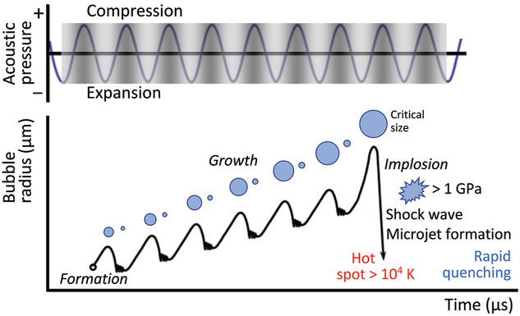
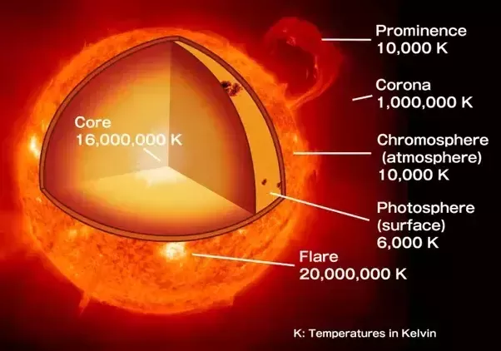
Risk of acoustic cavitation
MI needs to be reduced in order to avoid the formation of cavitation bubble and their explosion inside the vitreus body
Risk of transient visual disturbances and even permanent retinal or lens damage

Slide 17
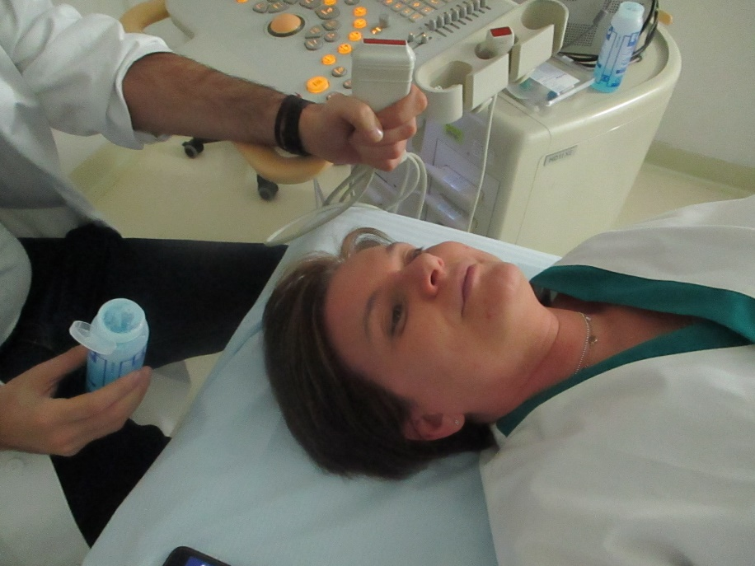
Protocol of examination
-The patient stays in supine position and with eyes closed.
-Examiner sits at the head side.

Slide 18
Protocol of examination
-Ultrasound settings should be adjusted to proper near field examination (depth and focus adjustement)
-The probe is placed on to the closed upper lateral eyelid on a transversal plane.
-the patient is asked to look straight ahead or to keep his gaze towards the ceiling

Slide 19
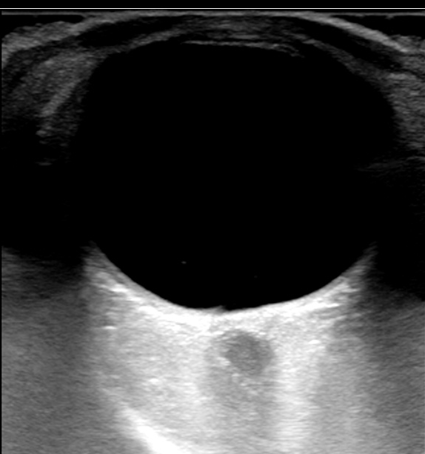
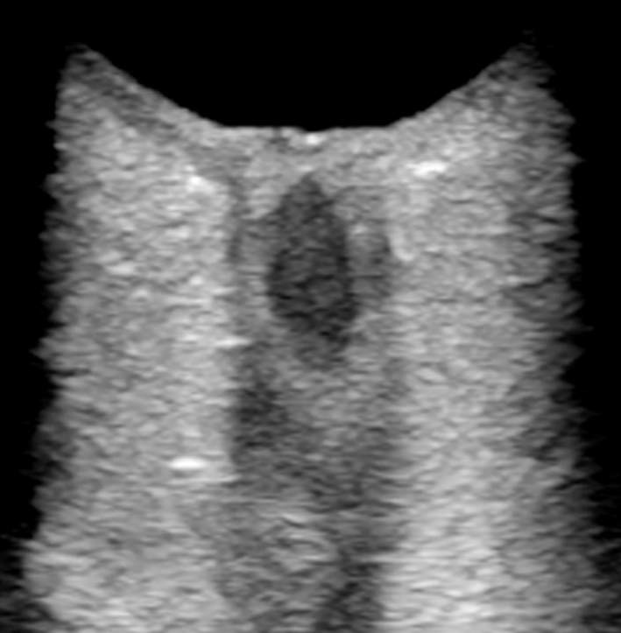
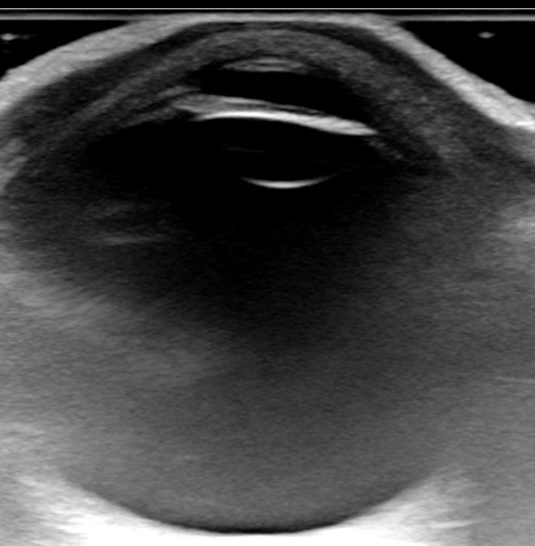
Protocol of examination
The anterior chamber of the eye and the vitreous body show up as an anechoic structure, whereas the lens shows up as a thin anechoic line.
The subarachnoid space between the optic nerve and the dura mater also appears hyperechoic due to reflections from the trabecular structure
The anterior part of the optic nerve and the optic disc are shown in their longitudinal course in the axial plane behind the eyeball. The optic nerve is shown in a longitudinal view and appears hypoechoic

Slide 20
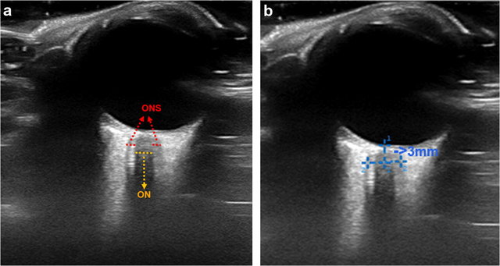
Measuring ONSD
ONSD <5 mm is normal
ONSD 5-6 mm is a “grey zone”
ONSD >6 mm is abnormal, suggesting ICP elevation
The ONSD and the diameter of the optic nerve itself (optic nerve diameter, OND) are determined according to the current convention at a depth of 3 mm behind the retina
Measure should be repeated 3 times and then avereged

Slide 21
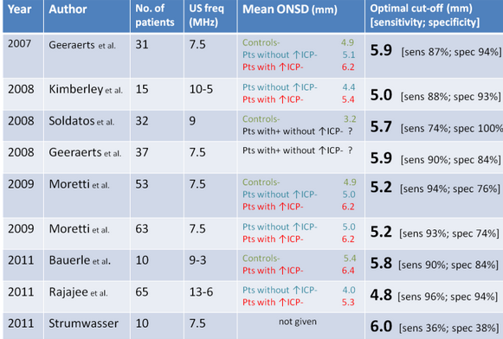
Measuring ONSD-normal values
ONSD <5 mm is normal
ONSD 5-6 mm is a “grey zone”
ONSD >6 mm is abnormal, suggesting ICP elevation
No established consensus!
Data from different settings!
No age/gender/race related normal values!

Slide 22
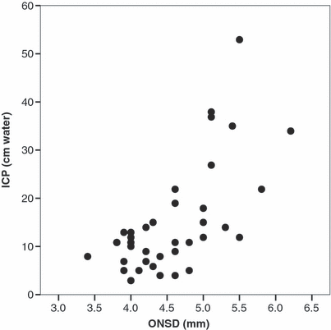
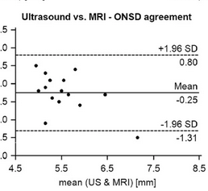
Measuring ONSD-reliability
ONSD vs ICP invasive monitoring (Kimberly 2008)
R 0.59 (p < 0.0005).
sensitivity of 88% (CI 47% to 99%) and
specificity of 93% (CI 78% to 99%)
ONSD vs MRI (Bauerle 2013)
(R = 0.72; p = 0.002)

Slide 23
Measuring ONSD-reliability
The pooled sensitivity was
0.90 (95% CI 0.80–0.95, p= 0.09), and the pooled specificity was 0.85 (95% CI 0.73–0.93, p = 0.13).
AUROC was 0.94 (95% CI 0.91–0.96), indicating a good level of accuracy

Slide 24
Measuring Papilledema
Various proposed cut-off values
Predominantly qualitative approach (YES/NO)
The presence of papilledema is assessed measuring the distance between the fundus and the dome of the papilla
The first caliper must be placed on the uppermost part of the swollen disc and the second caliper on the strongly reflecting line, which represents the lamina cribrosa.

Slide 25
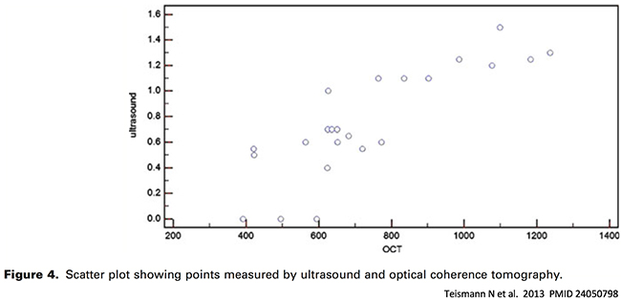
Reliability of US measurements
papilledema
-Lochner 2016 performed a prospective multicenter study comparing 21 patients with known intracranial hypertension versus age-matched controls. Ultrasonographic papilledema was present bilaterally in 20/21 (95%) of patients with intracranial hypertension, but was absent bilaterally in all 21 control patients.
-Teismann 2013 found that optic disc height on ultrasonography correlated well with optical coherence tomography among 14 patients evaluated in an ophthalmology clinic (r = 0.84).

Slide 26
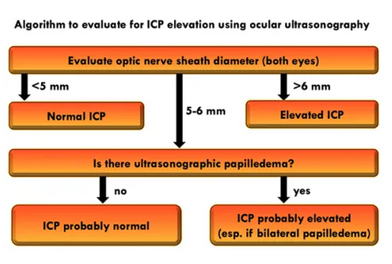
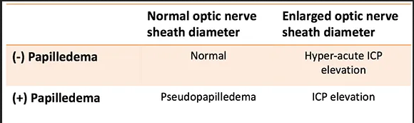
Proposed diagnostic algorithm

Slide 27
PITFALLS
Sometimes the optic nerve could be confused with the acoustic shadow casted by the lamina cribrosa.
To avoid this mistake:
-color Doppler helps in the correct identification of the
optic nerve (central retinal artery and vein)
-usually the optic nerve runs medially, while the acoustic shadow is linear

Slide 28
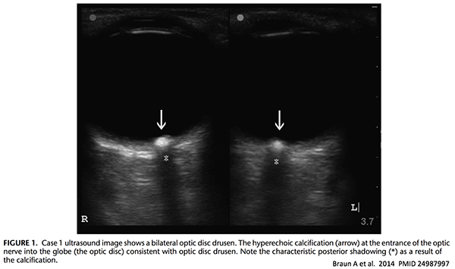
PITFALLS-2
Pseudopapilledema refers to anything causing otic nerve edema other than ICP elevation.
-Optic Disc Drusen: these are essentially bits of calcium within the optic disc. it creates a very bright signal which casts a clean shadow). Drusen may cause mild visual symptoms, but it's essentially a benign finding.
-Inflammation (generally due to optic neuritis, sarcoidosis, syphilis, or lupus). This is often unilateral, which may help differentiate it from papilledema (which is usually bilateral).

Slide 29
ultrasonographic evaluation of intracranial hypertension
Pros and cons
• reproducibility of measurements
• the non-invasive nature of the technique
• ready availability and portability of equipment
• rapid performance
• low costs
• avoidance of ionising radiation
• no consensus on threshold limits
• needs of specific echographic settings in order to avoid eye damage
•potential artifacts

Slide 30

Thank you for your attention!

